Slide 1
Hyperion Budget

Slide 2
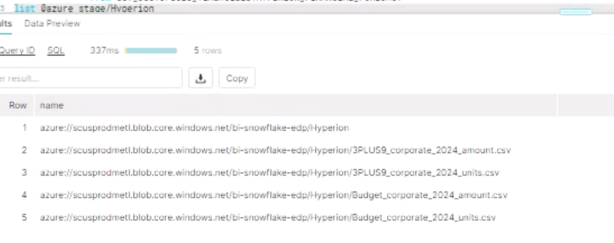
@ Azure Stage
Files are placed in the Hyperion Folder Azure Stage

Slide 3
Key words
Key words in the file name to process the Fact
1. Budget_corporate_2024_units.csv
2. Budget_corporate_2024_amount.csv
3. 3PLUS9_corporate_2024_units.csv
4. 3PLUS9_corporate_2024_amount.csv
Budget and 3PLUS9 – SCENARIO
Corporate, Segment -- FORECAST_LEVEL
Year - 2024

Slide 4
Files and Scenarios
Will be using csv file as input file
Scenarios going to use: Budget, 3plus9,6plus6,9plus3
Year format in the csv file should be 2023/2024 instead of FY23/FY24
Corporate/Segment level to be maintained in the CVS file name
Running the command of full refresh and dbt incremental are enough to load the file . No need to implement run operation of macro.
Macro is written to load the ods table and as well for the incremental operation

Slide 5
Steps to Follow
Make Sure Azure Stage is empty.
Place the Budget file and Truncate the dev_ods data (for testing purpose)
Run the model in full-refresh
Check for the data quality of this scenario
Then place the next input file in the stage.
Incremental run to be followed
Check for the data quality of both the scenarios.
The same steps to be followed for loading the rest of the files.

Slide 6
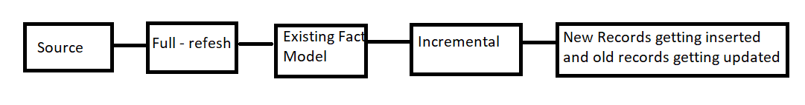
Concept of full load and incremental

Slide 7
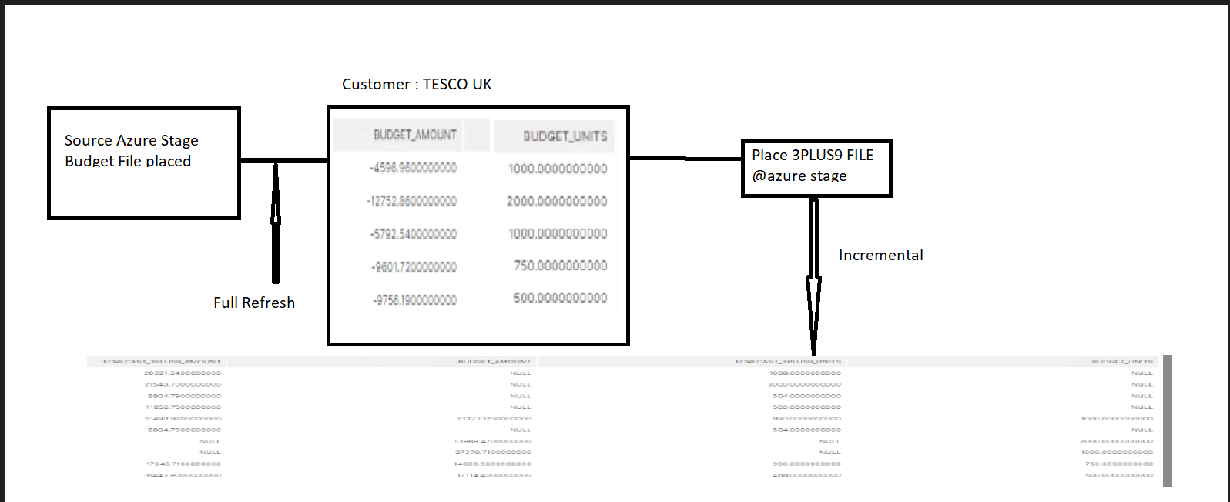
Full Refresh to Incremental

Slide 8
THANK YOU

